Slide 1
Worship- “WHAT”
Worshipper- “WHO”
Worshipping- “HOW”

Slide 2
Luke 10:38-42 Now it came to pass, as they went, that he entered into a certain village: and a certain woman named Martha received him into her house. And she had a sister called Mary, which also sat at Jesus' feet, and heard his word. But Martha was cumbered about much serving, and came to him, and said, Lord, dost thou not care that my sister hath left me to serve alone? bid her therefore that she help me. And Jesus answered and said unto her, Martha, Martha, thou art careful and troubled about many things: But one thing is needful: and Mary hath chosen that good part, which shall not be taken away from her.

Slide 3
John 4:21-23 Jesus saith unto her, Woman, believe me, the hour cometh, when ye shall neither in this mountain, nor yet at Jerusalem, worship the Father. Ye worship ye know not what: we know what we worship: for salvation is of the Jews. But the hour cometh, and now is, when the true worshippers shall worship the Father in spirit and in truth: for the Father seeketh such to worship him.

Slide 4
The
“Anato-ME” of a
Worshipper

Slide 5
The
“Anato-ME” of a
Worshipper
“WHO” The HANDS of a TRUE Worshipper

Slide 6
The
“Anato-ME” of a
Worshipper
“WHO” The HEART of a TRUE Worshipper

Slide 7
The
“Anato-ME” of a
Worshipper
“WHO” The TONGUE of a TRUE Worshipper

Slide 8
The
“Anato-ME” of a
Worshipper
“WHO” The TONGUE of a TRUE Worshipper
The Tongue is SMALL , but extremely POWERFUL

Slide 9
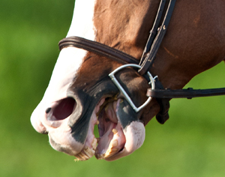
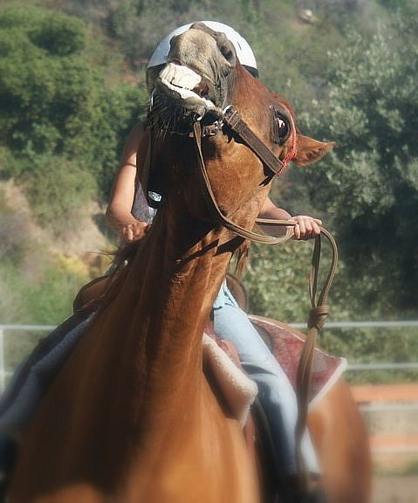
It’s like a Horse’s BIT

Slide 10
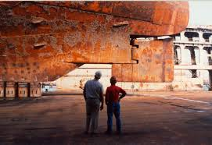
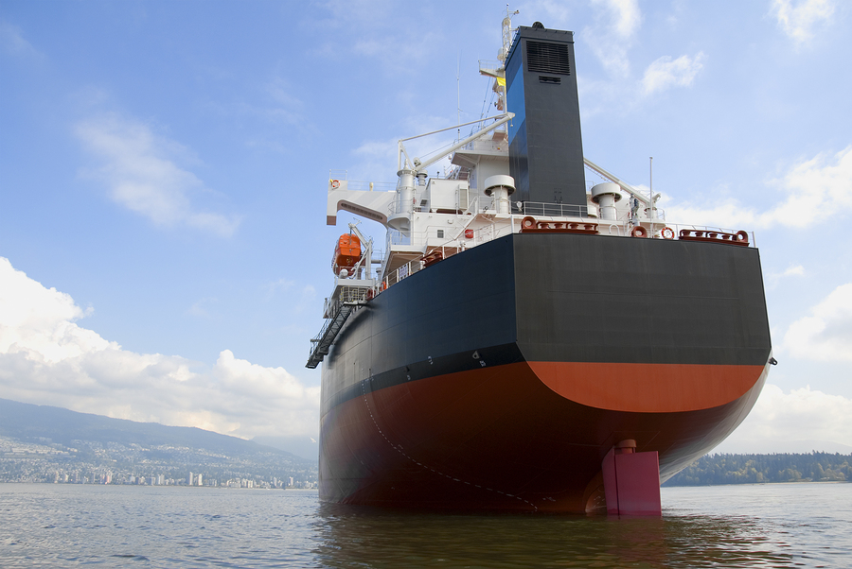
It’s like a Ship’s RUDDER

Slide 11
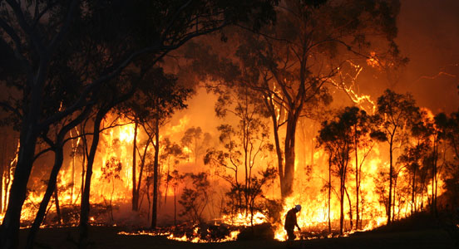
It’s like a Fire’s SPARK

Slide 12
The
“Anato-ME” of a
Worshipper
“WHO” The TONGUE of a TRUE Worshipper
The Tongue is SMALL , but extremely POWERFUL

Slide 13
The
“Anato-ME” of a
Worshipper
“WHO” The TONGUE of a TRUE Worshipper
The Tongue is NECESSARY, but extremely DANGEROUS

Slide 14
The
“Anato-ME” of a
Worshipper
“WHO” The TONGUE of a TRUE Worshipper
The Tongue is HELPFUL, but extremely INCONSISTENT

Slide 15
The
“Anato-ME” of a
Worshipper
“WHO” The TONGUE of a TRUE Worshipper

Slide 16
The
“Anato-ME” of a
Worshipper
“WHO” The TONGUE of a TRUE Worshipper
A PRAISING , not POISIONOUS , Mouth

Slide 17
Hebrews 13:15 By him therefore let us offer the sacrifice of praise to God continually, that is, the fruit of our lips giving thanks to his name.

Slide 18
Proverbs 11:9 An hypocrite with his mouth destroyeth his neighbour: but through knowledge shall the just be delivered.

Slide 19
Proverbs 15:28 The heart of the righteous studieth to answer: but the mouth of the wicked poureth out evil things.

Slide 20
Acts 17:21 (For all the Athenians and strangers which were there spent their time in nothing else, but either to tell, or to hear some new thing.)

Slide 21
Proverbs 15:28 The heart of the righteous studieth to answer: but the mouth of the wicked poureth out evil things.

Slide 22
The
“Anato-ME” of a
Worshipper
“WHO” The TONGUE of a TRUE Worshipper
A PRAISING , not POISIONOUS , Mouth

Slide 23
The
“Anato-ME” of a
Worshipper
“WHO” The TONGUE of a TRUE Worshipper
A BRIDLED , not BITING , Mouth

Slide 24
James 1:26 If any man among you seem to be religious, and bridleth not his tongue, but deceiveth his own heart, this man's religion is vain.

Slide 25
Luke 6:45 A good man out of the good treasure of his heart bringeth forth that which is good; and an evil man out of the evil treasure of his heart bringeth forth that which is evil:for of the abundance of the heart his mouth speaketh.

Slide 26
The
“Anato-ME” of a
Worshipper
“WHO” The TONGUE of a TRUE Worshipper
A PRAISING , not POISIONOUS , Mouth

Slide 27
The
“Anato-ME” of a
Worshipper
“WHO” The TONGUE of a TRUE Worshipper
A BRIDLED , not BITING , Mouth

Slide 28
The
“Anato-ME” of a
Worshipper
“WHO” The TONGUE of a TRUE Worshipper
A HEALING , not HURTING , Mouth

Slide 29
Ephesians 4:29 Let no corrupt communication proceed out of your mouth, but that which is good to the use of edifying, that it may minister grace unto the hearers.

Slide 30
Romans 15:5-6 Now the God of patience and consolation grant you to be likeminded one toward another according to Christ Jesus: That ye may with one mind and one mouth glorify God, even the Father of our Lord Jesus Christ.

Slide 31
1 Corinthians 1:10 Now I beseech you, brethren, by the name of our Lord Jesus Christ, that ye all speak the same thing, and that there be no divisions among you; but that ye be perfectly joined together in the same mind and in the same judgment.

Slide 32
The
“Anato-ME” of a
Worshipper
“WHO” The HANDS, HEART, TONGUE of a TRUE Worshipper

