Slide 1
Who Really Owns Our Land
Federal vs. State and Private Ownership

Slide 2
Who Really Owns Our Land
The bulk of information presented here is from the Congressional Research Service & was prepared for Members and Committees of Congress
The report was dated Feb. 2012
As you can imagine the report was not particularly critical of Govt. & I expect the numbers are accurate
The tables presented are a part of that report
This barely scratches the surface but I was amazed by the scope & breadth of the federal control they hold (administer) over the land & do not intend to let go

Slide 3
Who Really Owns Our Land
This presentation was prompted by the recent events at the Bundy ranch (recent history) (national news)
This dates back to 1934 (grazing division) established as part of the New Deal to administer grazing on public range lands (not certain when fees originated)
To me the key word is public as it is owned by taxpayers
Bundy History;
In 1989 the Fish and Wildlife Service designated the desert tortoise an endangered species

Slide 4
Who Really Owns Our Land
In 1990 the designation was changed to ‘threatened”
The Bureau of Land Management (BLM) designated hundreds of thousands of acres for strict conservation efforts (elimination livestock of grazing, 4 wheeling etc.)
If killing tortoises was caused by cattle there would be none; 60 million bison grazed the U.S. prior to any cattle
Land the Bundy's had homesteaded since 1887
Bundy has been repeatedly fined since 1993 and has not paid fees of around $300K (the rest is fines & interest)
The BLM revoked his permit and Bundy has not filed for a new one

Slide 5
Who Really Owns Our Land
Through April of 1995 the fight between the BLM & the ranchers like Bundy intensified
The ranchers demanded no Govt. fees and no oversight by the BLM associated with grazing rights
In March of 1996 12 lawsuits were pending against 12 ranchers (not certain of the outcome of lawsuits)
In 1998 a federal judge issued an injunction against Bundy ordering him to remove cattle from public land

Slide 6
Who Really Owns Our Land
In 2002 another rancher was also fined and put on probation for a similar offence
In 2009 the BLM posted public land against grazing of cattle & off road vehicles etc.
In 2012 the BLM makes plans to round up Bundy cattle
In 2014 the actual round up took place
Bundy claimed the federal Government did not own the land and did not have the right to charge fees for its use (basically unconstitutional)

Slide 7
Who Really Owns Our Land
For unauthorized grazing of cattle The Bundy family faced persecution not seen since Ruby Ridge or Waco
Bundy’s son was arrested & teased for kicking a rather aggressive police dog
His sister was assaulted & thrown to the ground
140 of his cattle were slaughtered + 2 prize bulls and irrigation systems were destroyed (worth $1 M)
Swat teams and snipers were deployed
Right or wrong more rational people should be in charge where our Govt. is concerned

Slide 8
Who Really Owns Our Land
According to Fox News Bundy lost in Federal Court & I believe he represented himself (big mistake)
I will cover the BLM in depth later however, they do administer more lands than any other federal agency
The BLM manages a total of 247.9 million acres 99.8% of which is in 11 western states
We in the east really have little or no experience with the BLM
I can’t see how citizen can obtain a reasonable ruling in Federal Court depending who selected the judges

Slide 9
Who Really Owns Our Land
I have a similar experience with another agency, the FDA (not land but control of property)
We started a medical device business in 1995
At that time medical devices had to be registered with FDA, nothing more
In 2007 the FDA decided to increase their funding
All medical devices had to pay a registration fee just to sell a product in the U.S.
It started out at $1700 per yr.; per product and is now over $3300 per yr. with no end in sight

Slide 10
Who Really Owns Our Land
Is this kind of government financing power that the founding fathers envisioned? (I think not)
Don’t think this doesn't effect you because it does.
All government intervention increases cost and decreases availability of product; no exceptions
You as the consumer will pick up the additional cost somewhere down the supply chain
If you have 100 products, as a business you pay over $330,000 per yr. to the FDA just to market
Your medical cost just increased and so did the cost of your steak

Slide 11
Who Really Owns Our Land
One of my major issues with the federal government is mismanagement and priorities (political interference)
This has always been the case and the constitution was constructed to eliminate this but did not always succeed The Bundy case is no exception (looking back at history)
The U.S. federal government was heavily influenced by the struggle for control of “western lands” and debt
Land between the Appalachian Mountains and the Mississippi was claimed by the original 13 colonies
This was managed by the North West Ordinance of 1787. Major changes occurred after the war with Mexico in 1848

Slide 12
Who really Owens Our Land
We did cover some of the Northwest Ordinance of 1787 last meeting
All new states would come into the union on equal footing
It was assumed when a territory received statehood all ungranted property would be sold to the people in the state
Only a small amount required for necessary federal government functions was to be retained by Govt.
In 1803 when Ohio was admitted to the union the govt. retained title to all ungranted public land

Slide 13
Who Really Owns Our Land
Ohio would acquire jurisdiction as soon as these lands could be sold to pay off the national debt
This became the established policy for new states
The Govt. would retain all ungranted public land
It would expedite disposal
Jurisdiction would revert to the state when the land was sold
As a result all states east of the Mississippi and the Louisiana Purchase acquired all land within their boundaries except that required for govt. functions

Slide 14
Who Really Owns Our land
How did we get from there to here? (very simple)
When the territory of the western states was acquired from Mexico, Congress digressed form the constitution
Congress now eliminated the sale or dispersal of ungranted lands. Ungranted land reverted to govt.
The policy resulted in the Federal Govt. becoming the permanent owner & manager of 28% of the American landmass, 2.27 billion acres

Slide 15
Who Really Owns Our Land
Land settlement accelerated through the Louisiana Purchase in 1803 and the Oregon Compromise with England and cession of lands (Mexican War) after 1848
Congress enacted numerous laws to accelerate the settlement of the west (land can’t be held unless occupied)
Homestead act of 1862
Desert Lands Entry Act of 1872
816 million acres of public domain was transferred to private ownership (personal & business) from 1871 to 2010 (rail roads)

Slide 16
Who Really Owns Our Land
Currently the Federal Govt. owns and manages 635-640 million acres
Four agencies manage 609 million acres of land
Department of Interior (DOI) & the National Park Service (NPS)manage 80 million acres
The Bureau of Land Management (BLM) manages 248 million acres
The Fish & Wildlife Service (FWS) manages 89 million acres plus 217 million acres of marine refuges & monuments

Slide 17
Who Really Owns Our Land
The Department of Agriculture, the Forest Service (USFS) manages 193 million acres
Most of these lands are in the West including Alaska
The Department of Defense (DOD) administers 19 million acres in military bases, training ranges etc.
The remaining several million acres (estimated) are managed by a variety of government agencies
Conflicting public values concerning federal lands raise many questions & issues; as taxpayers do we own the land and is it only managed by the government?

Slide 18
Who Really Owns Our Land
Another 328 million acres was granted to states
Another 142 million acres was granted to Alaska under native selection laws
In 1871 Yellowstone National Park was created and protected by the U.S. Army (poachers & timber theft)
Concern over timber harvests and flooding led to formation of forest reserves (renamed national forests in 1907)
In 1934 the Taylor Grazing Act was enacted (this was Bundy’s issue along with other ranchers)
In 1976 the Federal Land Policy and Management Act (FLPMA) was passed and congress declared that remaining public domain lands would remain in federal ownership

Slide 19
Who Really Owns Our Land
This decision has some far reaching effects in today's world
Remember, as far as I know, we are the only nation in the world where individuals have mineral rights
This keeps all remaining mineral rights under Govt. control and in effect regulates prices & availability
Almost all new oil drilling and all fracking is performed on private parcels where the Govt. has no control
Much to the Govt. chagrin we are now the worlds largest producer of natural gas

Slide 20
Who Really Owns Our Land
In my opinion this does not fit their plan and they have made every attempt to control/stop fracking
This is one of the few areas that is keeping our economy from collapsing
This is another example of capitalism vs. socialism
Capitalism wins every time, no contest
We should be developing energy resources to their fullest potential, lower energy prices, export energy and start to reduce our debt

Slide 21
Who Really Owns Our Land
You can’t scam logic and that is why it sucks for most elected officials (ain’t much money in it)
Another issue is that some of the bureaucracies that control our land date back over a century
That is a long time to burrow in to the woodwork
I believe elected officials consider these bureaucracies an involuntary action like breathing
Many elected officials don’t know many exist or even what they are responsible for

Slide 22
Who really Owns Our Land
The big issue I have is cost and inefficiency
As an example let’s look at the National Forest Service
My wife comes from a small paper mill town in Rumford Me.
You either work in the hospital or the mill or not at all
My brother-in-law is an electrician in the mill
As a company project he was assigned to a task team

Slide 23
Who Really Owns Our Land
The task was to visit Weyerhaeuser somewhere out west
What they learned is that Weyerhaeuser maintained their land better than the Govt.
They cleaned up brush on the forest floor reducing the risk of forest fires to properly manage resources
In another instance that made national news; a large brush fire occurred in the Lake Tahoe area
The only home to survive was one where the homeowner illegally cleared brush from around his home
Remember Einstein; stupidity vs. genius

Slide 24
Who Really Owns Our Land
The point is if the land was sold and properly developed in many cases resources would be better conserved
What amount of forest resources go up in flames every year?
There are an unending number of examples
I am also certain that most all original intentions were for the best interest of the nation
The best laid plans of mice & men
Let’s look at the agencies in some detail

Slide 25
Who Really Owns Our Land
The vast majority of all land management falls under the U.S. Department of Interior (DOI)
It is a Cabinet level agency that manages Americas natural & cultural resources; created in March 1849
DOI employs 70,000 people and has nine bureaus
Bureau of Land Management
National Park Service
U. S. Fish and Wildlife Service
U. S. Forest Service (Under the Department of Agriculture) USDA

Slide 26
Who Really Owns Our Land
The first four listed are the major players of our land & resource management
Together they administer 609.4 million acres
This is roughly 95% - 96 % of the 635-640 million acres of land owned by the federal Govt.
The Department of Defense DOD also administers 19.4 million acres of federal land (bases test facilities etc.)
There are others, post office, space administration etc. They are minor players in the area of land management

Slide 27
Who really Owns Our Land
The rest listed below are part of the nine under the DOI and most are not detailed in this presentation
Bureau of Safety and Environmental Enforcement
Office of Surface Mining, Reclamation and Enforcement
U. S. Geological Survey
Bureau of Indian Affairs
Bureau of Ocean Energy Management
Bureau of Reclamation

Slide 28
Who Really Owns Our Land
The Forest Service, the oldest of the four land management agencies was officially created in 1905
It was later joined with the USDA
It administers 192.9 million acres mainly in the west
National Park Service was created in 1916. It manages 79.7 million acres of federal land in 49 states; 66% of which is in Alaska
It manages 397, units, one of which is Gettysburg
Its mission – preserve unique resources for public use

Slide 29
Who Really Owns Our Land
Fish and Wildlife Service established by executive order in 1903
Today the FWS administers 88.9 million acres of federal land, 76 million acres, 86% is in Alaska
Primary mission – to conserve plants and animals
Land use must be compatible with species needs; timber, oil or gas drilling, grazing & mining of minerals are subject to their jurisdiction
Authority seems to overlap between agencies

Slide 30
Who Really Owns Our Land
Bureau of Land Management BLM was formed in 1946 by combining the 1934 Grazing division (Bundy’s nightmare) & The General Land Office created in 1912.
This is the 800 pound gorilla in the room
The BLM administers more federal land than any other agency; 247.9 million acres, 99.8% in the 11 western states (remember we departed from the constitution in 1849)
The BLM does overlap many areas of the USFS

Slide 31
Who Really Owns Our Land
Because of the similarity of their missions merging the USFS and the BLM & has been proposed
The BLM concentrates mainly on rangelands and in addition administers mineral development on all federal lands (700 million acres subsurface minerals)
Besides classifying the tortoise as endangered the BLM has classified wild mustangs as pests.
Mustangs are rounded up and sent to slaughter houses mainly outside the U. S.

Slide 32
Who Really Owns Our Land
The Department of Defense was created by the national security act of 1947 (later renamed DOD)
As previously stated DOD manages 19.4 million acres
Management of land on federal military reservations was retained by the individual military services.
Border Security; a major concern for all Americans!
There are extensive federal lands along the southwest border; precise estimates of acreage involved are not feasible according to the information in this congressional report

Slide 33
Who Really Owns Our Land
Estimates from the House Committee on Natural Resources are 26.7 (not exact) million acres within 100 miles of the border (excluding 3.5 million acres of Indian land
Nearly half, 12.3 million acres is managed by the BLM
Border control on federal lands is hindered by mission differences and jurisdiction between agencies; Department of Homeland Security (DHS), USFS, & DOI.

Slide 34
Who Really Owns Our Land
The U.S. Border Patrol (USBP) is the lead agency for border security between ports of entry
Over 40% of our southwest border abuts federal and tribal lands overseen by the USFS & four DOI agencies including the Bureau of Indian Affairs which is not a land management agency
Indian lands (reservations) have their own separate law enforcement (not border security)
The only law enforcement allowed on Indian lands other than Indian security is the FBI

Slide 35
Who Really Owns Our Land
Three departments – DHS, USDA, (for the USFS) & DOI have signed a Memoranda of Understanding (code for B.S.) with regard to border security (communication & inter agency access)
Notice the Forestry Service didn’t have the autonomy to sign for itself
2/3 of the USBP southwest agents experienced delays and restrictions when attempting to access certain federal lands under another's domain
From my perspective this sheds a whole new light on border security issues I was not aware of

Slide 36
Who Really Owns Our Land
In summary the federal Govt. owns 635-640 million acres and has no Intention to return it to the people
That is 28% of the total U.S. land mass
62% of Alaska and 47% of 11 western states is owned by the federal govt.
By contrast the govt. owns 4% of lands in other states
That is the result of by-passing the Constitution
Many of the original intentions may have been for the right reasons, however much has gone astray

Slide 37
Who Really Own Our Land
At a recent seminar a speaker described govt. agencies as silos in a row without benefit of communication
I thought it appropriate & an excellent analogy
Some of the Govt. agencies have been around for over 100 years many over 50 years
They have become part of the wallpaper and congress refuses to revisit past history (painful)?
They just add, combine or reshuffle the pieces which ever is politically expedient - because we have such short memories it works

Slide 38
Who Really Owns Our Land
The result is the unorganized, unmanageable mess we have today
Business could not stay viable under such conditions
Most administrations have over 50% of cabinet officials and department heads with business expertise
This administration has only 8%, notice the difference?
However, this administration did not create all this chaos
But certainly lacks the talent and interest to make required logical changes to improve anything

Slide 39
Who Really Owns Our Land
The ownership of our land by the government has an effect on all of us on a daily basis
Many of the agencies have overlapping jurisdictions which increase cost, generate friction & delay action The amount of money wasted boggles the mind
The Bundy episode is a good example.
The govt. paid $900,000 to have Bundy’s cattle rounded up, as reported on Fox - why?
This does not include the cost to deploy personnel. There were other ways to deal with this

Slide 40
Who Really Owns Our Land
The DOI employs over 70,000 and with the USBP (number of personnel unknown) we have no border security
With all the land we own we should establish military training bases and be in control of our land & border
If properly managed we could sell off much govt. land to private interest
Many private firms would guard the resources as a return on their investment such as Weyerhaeuser

Slide 41
Who Really Owns Our Land
It would also be a way to reduce the debt
Developing energy resources to their fullest extent would also reduce our debt and elevate our status in today's world
New business would increase revenue to the treasury
We need to streamline many century old agencies & eliminate overlapping jurisdictions
Where feasible we need to return the land to the states and the people. The govt. as administrator is failing to efficiently manage the land and failing the people (the real owners) as well

Slide 42
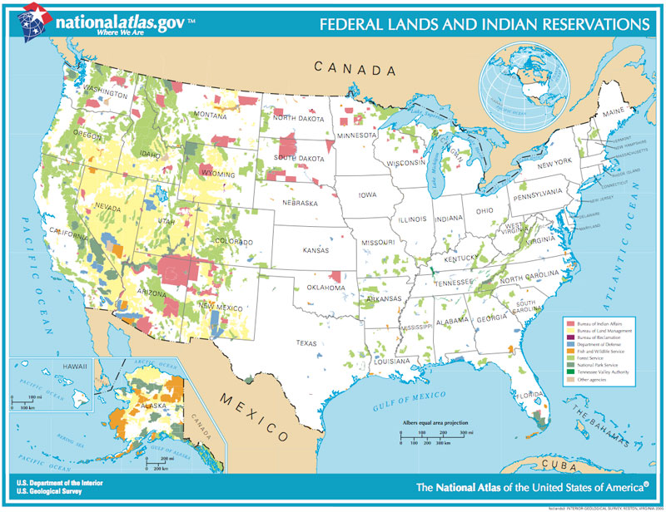

Slide 43
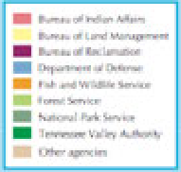

Slide 44
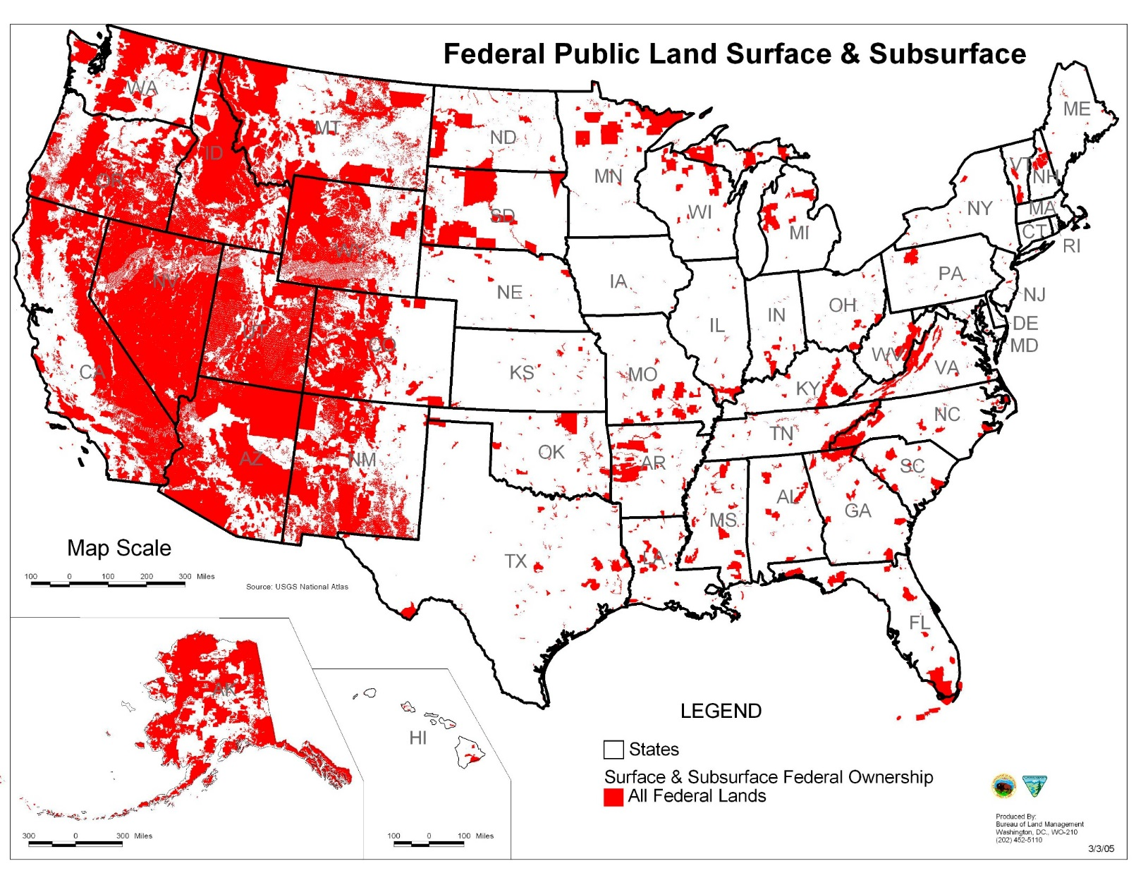

Slide 45
• H.R.2657 — 113th Congress (2013-2014)
Disposal of Excess Federal Lands Act of 2013
Sponsor: Rep. Chaffetz, Jason [R-UT-3] (Introduced 07/11/2013)
Cosponsors: 0
Latest Action: 04/10/2014 Placed on the Union Calendar, Calendar No. 303
• H.R.3006 — 113th Congress (2013-2014)
To authorize a land exchange involving the acquisition of private land adjacent to the Cibola National Wildlife Refuge in Arizona for inclusion in the refuge in exchange for certain Bureau of Land...
Sponsor: Rep. Calvert, Ken [R-CA-42] (Introduced 08/02/2013)
Cosponsors: 3
Latest Action: 03/25/2014 Subcommittee Hearings Held
• H.R.2398 — 113th Congress (2013-2014)
To prohibit the Secretaries of the Interior and Agriculture from taking action on Federal lands that impede border security on such lands, and for other purposes.
Sponsor: Rep. Bishop, Rob [R-UT-1] (Introduced 06/17/2013)
Cosponsors: 12
Latest Action: 08/13/2013 Referred to the Subcommittee on Conservation, Energy, and Forestry

Slide 46
• H.R.3294 — 113th Congress (2013-2014)
State-Run Federal Lands Act
Sponsor: Rep. Young, Don [R-AK-At Large] (Introduced 10/15/2013)
Cosponsors: 0
Latest Action: 12/11/2013 Referred to the Subcommittee on Conservation, Energy, and Forestry
• S.1233 — 113th Congress (2013-2014)
Federal Land Freedom Act of 2013
Sponsor: Sen. Inhofe, James M. [R-OK] (Introduced 06/26/2013)
Cosponsors: 13
Latest Action: 06/26/2013 Read twice and referred to the Committee on Energy and Natural Resources.
• S.1049 — 113th Congress (2013-2014)
A bill to direct the Secretary of the Interior and Secretary of Agriculture to expedite access to certain Federal lands under the administrative jurisdiction of each Secretary for good Samaritan...
Sponsor: Sen. Heller, Dean [R-NV] (Introduced 05/23/2013)
Cosponsors: 3
Latest Action: 05/23/2013 Read twice and referred to the Committee on Energy and Natural Resources.

Slide 47
Smart growth, open spaces, endangered species, redevelopment, social justice.
10 years ago. We never heard of these words.
Okay, you say interesting, but I'don’t see how that really affects me.
First, before I get going I want to say that yes I know it is a small world and what we do affects other countries and what they do affects us, but this is we are not all one planet under one rule. I also know we have a government of the people by the people and for the people and as cumbersome as that may be sometimes. Just think if we were in China they don't ask the people if they agree they just do it. We have three branches of government, the Bill of Rights, the Constitution and self-determination. As we continue, please remember these things.
I am not against alternative energy recycling, reusing products sensibility to saving endangered creatures or wasting our resources

Slide 48
Smart growth Open spaces three important factors to life are food, water, shelter. A large portion of our land is now being regulated by the BLM. Land that belong to the people They control all the resources timber, (needed for buildings, shelter) water to drink restrict our rights to use it for irrigation, food they, limit the use of the land for grazing activities. They control. How much oil and gas is allowed to be produced by limiting the permits... There are regulations on restricting access or recreational purposes. They taking control of our lives

Slide 49
Redevelopment . Towns are now providing funding for infrastructure and development for private projects. They use Redevelopment agency funds your money specifically, your property taxes. Notice how there is very little money in your general fund. Most of that is going to pay for the police and fire. Redevelopment Depts.are the only agency in the government that can float a bond without a vote of the people and now you're paying off these bonds for next 45 years with your property taxes. Another great redevelopment tool is cities have the right to take property by eminent domain against the will of the property owner can they give it or sell it to a private developer stating that it's for the better good. By declaring an area of the town blighted( in some cities. Over 90% of the property is declared blighted) property taxes in that area can be diverted away from the general fund, by making them tax free zones. This constriction of available funds is destroying our cities and forcing them to offer less and less services and reducing our standard of living

Slide 50
Social justice People should be rounded up off the land packed into human settlements were islands of human habitation close to employment shopping centers, public housing and private transportation will not be needed Americans need to be controlled. Only then will they say there will be social justice. Then why is it people from around the world aspire to achieve the levels of prosperity we have in this country.

Slide 51
In a nutshell, this is a whole life plan for the government to take control of the educational system, energy market, and transportation system. The health care system, food production and all of the land use and not leave any decision-making in the hands of private property owners. It is assumed that we are not good stewards of the land that government will do a better job if they are in control. Individual rights in general, are to give way to the needs of the communities as determined by the government

Slide 52
There is no constitutional authority for the federal government to own lands that are located inside state borders ;( territorial lands. Yes); but not once they become states. These lands must be turned over to the states. The federal government is in breach of contract with many Western states for continuing to maintain the control of these lands; of which most of it is called public lands is not even accessible and is close to the public.
We know that the federal government owns nearly 1/3 of the land US. You might ask, what are they doing with it? The answer is certainly not making the most of it.

Slide 53
Did you know the US government ( Dept. of the Interior,the Dept. of Agriculture and Dept. of Defense )controls the use of this property.About 97% of Alaska 87% of Nevada. And it is the largest landowner in California. California has the highest mountain in the lower 48 is controlled by two US departments Department of Agriculture on the east side and on west side by Department of the Interior. If you want to hike Mount Whitney you now need a permit. Very few mountains on Earth require a permit. The Department of Agriculture rules are much more stringent in the Department of the Interior. Department of Agriculture's make hikers purchase and carry bear can. It is a deterrent spray for protection. In the 40 years that people have hiked there. They have never seen a bear.

Slide 54
That means that we the taxpayer pay for two separate administrators for one area. All this land should be turned over to the state of California.
Now here's a thought federal buildings, military installations and facilities, national parks com prize about 7% of all US land at least about 25% of the US land being held by the government that is currently not used for government enterprise. It is underutilized asset that we have people own.

Slide 55
What if the government was to auction off some of this land to American citizens(not corporations) for purposes of retiring the national debt? While there should be some limitations such as the land needs to be held by a valid US citizen, which can be passed to the heirs or sold to another US citizen. The citizen then if they so desired, could lease the land to American businesses or industry and now that land can be productive for energy production, mineral rights, agriculture, grazing or homesteading, which in turn could create energy independence, and millions of jobs and get us out of this jobless recovery.

Slide 56
Executive Order 13575 signed in June 2011 giving Federal agencies authority over “food, fiber and energy.
Executive Order 13602 signed in March 2012 giving HUD the authority to engage in community, city and regional planning.
Cliven Bundt of Nevada is fighting the BLM over grazing rights, Thomas Henderson is in dispute of property line along the Red River, and the State of Texas is fighting the BLM over 90,000 Acers along that same river. 9 Western States held a summit stating it is time to take control of the Federal lands in their State. So I say to you isn’t time we take back the control. What happened to WE THE PEOPLE?

